Slide 1
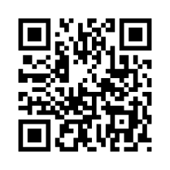
Can a Comedic Advertisement Help Combat Misinformation? A Qualitative Analysis of a Pilot Study
Kendall Beaver
¹Affiliations
Introduction
Results
Use incomplete sentences
Smallest size body text 36
Keep word count to minimum
Image
Image
Image
Use incomplete sentences
Smallest size body text 36
Keep word count to minimum
Use incomplete sentences
Smallest size body text 36
Keep word count to minimum
Materials and Methods
Image
Image
Image
Use incomplete sentences
Since this is description, this is allowed to be slightly smaller
Keep word count to minimum
Use incomplete sentences
Since this is description, this is allowed to be slightly smaller
Keep word count to minimum
Discussion
Acknowledgements & References
Use incomplete sentences
Smallest size body text 36
Keep word count to minimum
Image
This is the one section you can use complete sentences to thank those that helped you on your project. Include whoever you would like. Additionally, don’t forget about your logos. You need the KEYS, BIO5, and Ken R. Coit College of Pharmacy logo and those required by your lab.
Use incomplete sentences
Since this is description, this is allowed to be slightly smaller
Keep word count to minimum
Use incomplete sentences
Since this is description, this is allowed to be slightly smaller
Keep word count to minimum
Image

